Slide 1

Variational autoencoders for image deconvolution in fluorescence microscopy Sai MUTTAVARAPU Research tutors: Laure BLANC-FÉRAUD and Luca CaLATRONI
Academic professor: Michel RIVEILL

Slide 2
Agenda
Introduction
Related work - Diversity Noising (DivNoising)
Proposed work – Diversity Blurring (DivBlurring)
Results
Conclusion and Future work
2

Slide 3

Abstract
High precision is essential in biomedical imaging.
Denoising is not only the solution to find the images which can detail all required information, deblurring is also necessary.
Our approach “DivBlurring” is an inverse image reconstruction model reconstructing biomedical images from an inverse problem perspective.
The task is reconstructing the desired image from the noisy and blurry data by using generative approaches such as variational auto encoder in combination with the use of a physical model.
3

Slide 4
Institute and Team
The research was conducted in the team “MORPHEME” which is joint research team among Inria, I3S and iBV.
Inria (National Institute for Research in Digital Science and Technology).
I3S (Computer Science Signals Systems Laboratory).
iBV (Institute of Biology Valrose).
Team MORPHEME is established in 2010.
The main objective of the team is to address biological challenges based on imagery with Image acquisition, Feature extraction, Classification and modelling.
4

Slide 5
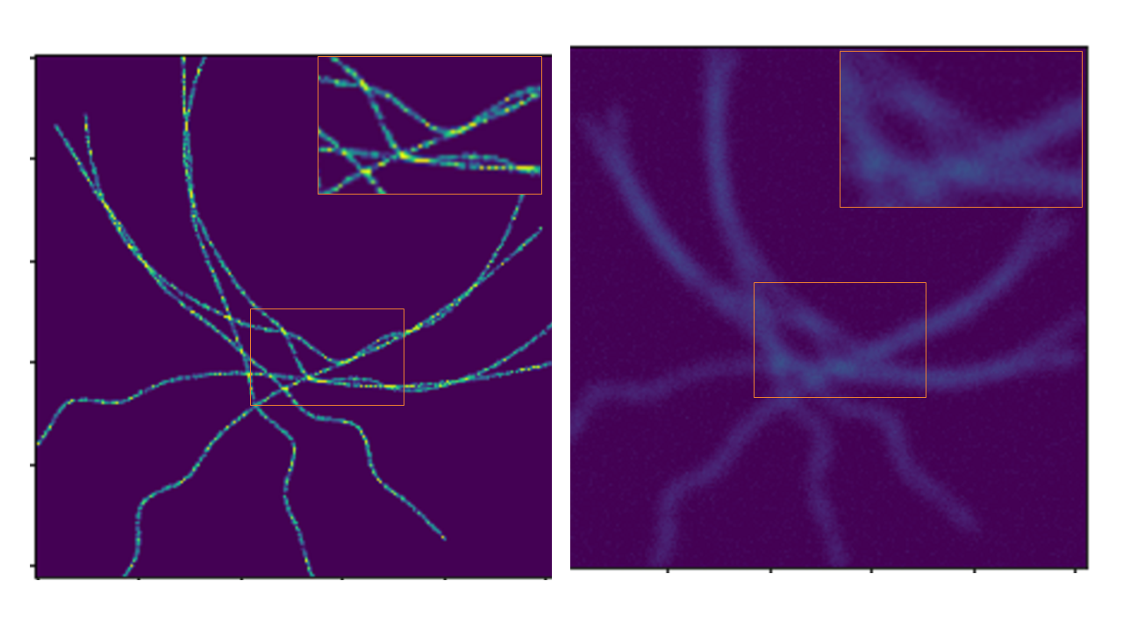
Introduction
Visualization of cells, molecules and other related biological samples is important problem in biomedical imaging .
There is a data loss between real sources image and observed source image in fluorescence microscopy.
Instrumental constraints and techniques used to capture the object impacts object quality such as diffraction of light.
$$x y$$
5

Slide 6
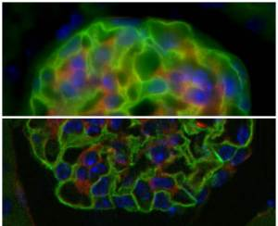
Introduction
$$y$$
The objects we capture when we illuminate the light on specimen.
Fluorescence microscopy techniques are blurred due to the diffraction of light.
This process can be modelled mathematically as a convolution of the object with a certain blurring source specific of the microscope called Point Spread Function (PSF).
$$x$$
Sources: (James Jonkman et al., 2012),(From Wikipedia, 2010)
6

Slide 7
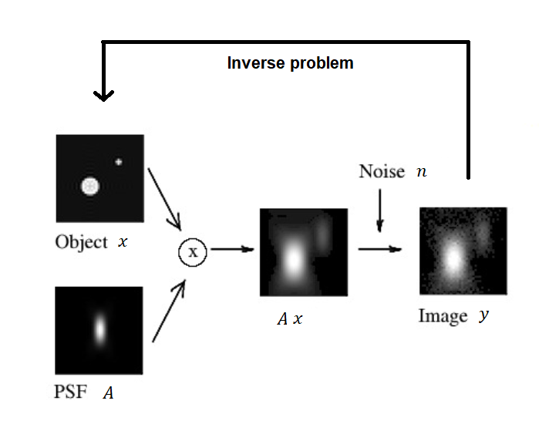
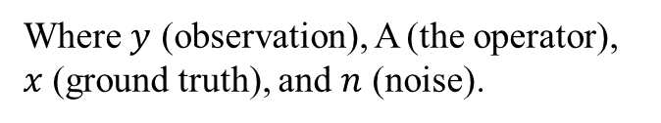
Introduction
In fluorescence microscopy, the observed image is an added noise and blur version of real image which we are interested to find.
The real image can be estimated by solving an inverse problem which estimating learnable parameters or data from the inadequate observations.
The problem is ill-posed.
$$y=Ax+n$$
Where $y$ (observation), A (the operator), $x$ (ground truth), and $n$ (noise).
7

Slide 8
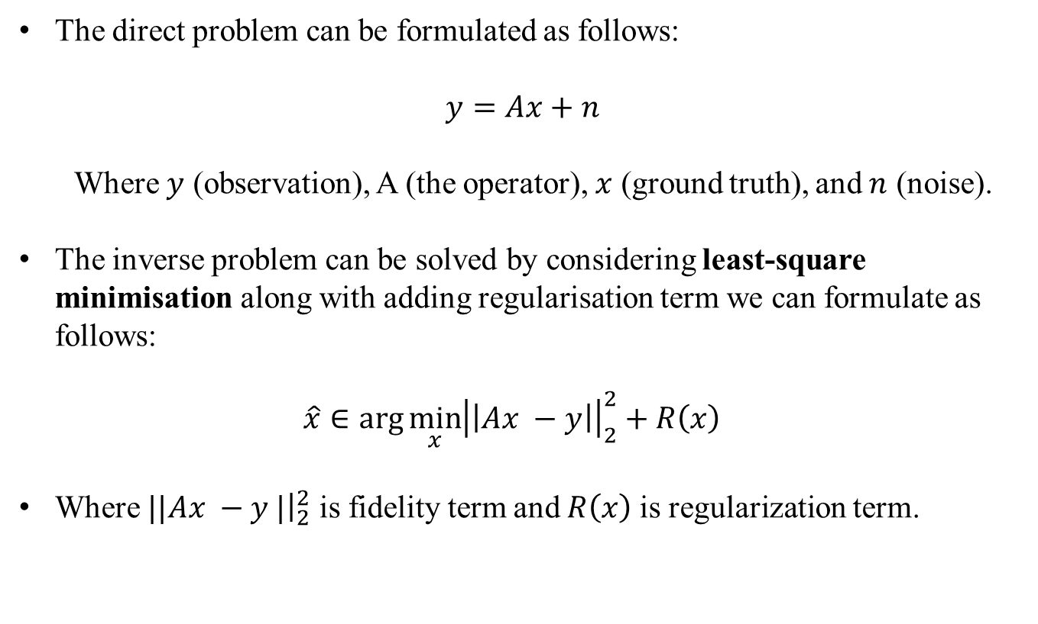
Inverse problem: mathematical formulation
The direct problem can be formulated as follows:
$$y=Ax+n$$
Where $y$ (observation), A (the operator), $x$ (ground truth), and $n$ (noise).
The inverse problem can be solved by considering least-square minimisation along with adding regularisation term we can formulate as follows:
$$\hat{x}∈\arg{\min_{x}{{\left|\left|Ax −y\right|\right|}_{2}^{2}+R\left(x\right) }}$$
Where $||Ax −y |{\left.​\right|}_{2}^{2}$ is fidelity term and $R\left(x\right)$is regularization term.
8

Slide 9
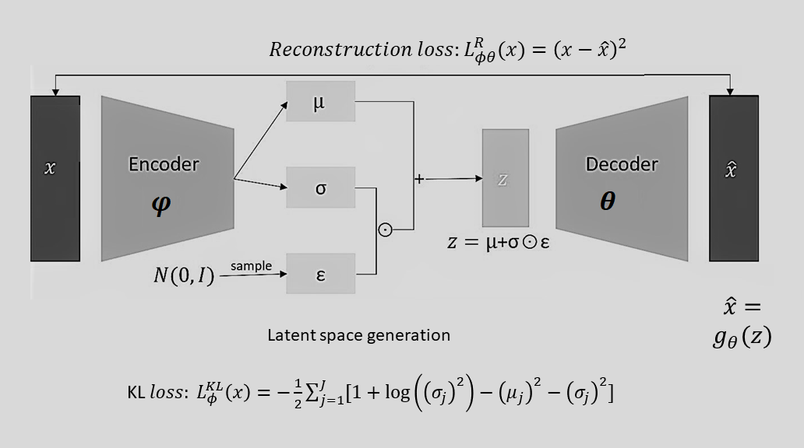
VAE
VAE with $φ and θ$ are the training parameters in encoder and decoder respectively, where $z$ is a latent representation of $x.$
(Diederik P. Kingma et al., 2014)
9

Slide 10
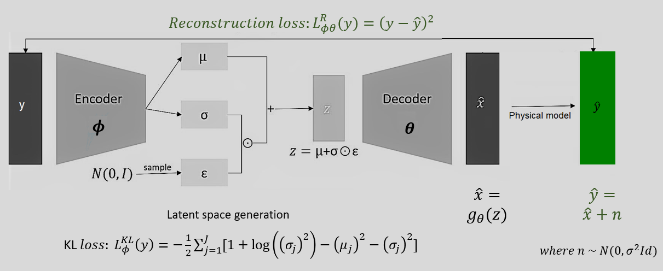
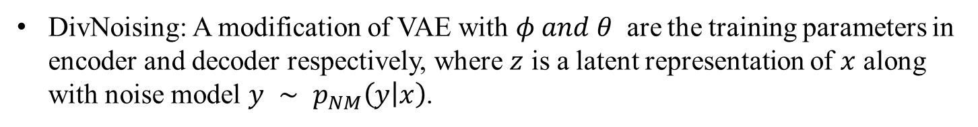
DivNoising
DivNoising: A modification of VAE with $φ and θ$ are the training parameters in encoder and decoder respectively, where $z$ is a latent representation of $x$ along with noise model $y ∼ p_{NM}\left(y | x\right)$.
(Florian Jug et al., 2021)
10

Slide 11
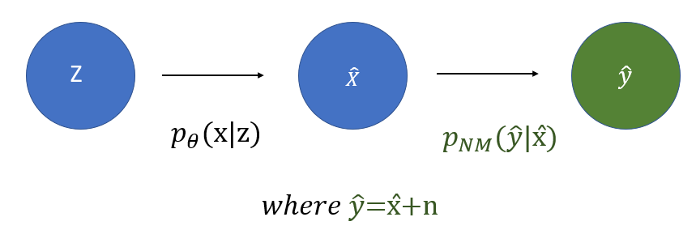
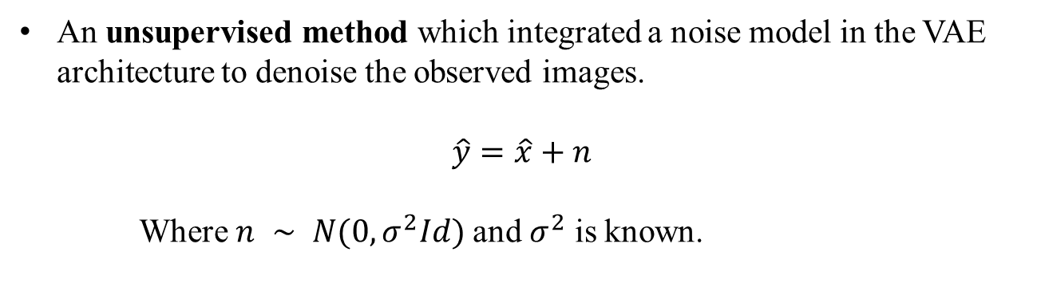
DivNoising
An unsupervised method which integrated a noise model in the VAE architecture to denoise the observed images.
$$\hat{y}=\hat{x}+n$$
Where $n ∼ N(0, σ^{2}Id)$and $σ^{2}$ is known.
(Florian Jug et al., 2021)
11

Slide 12
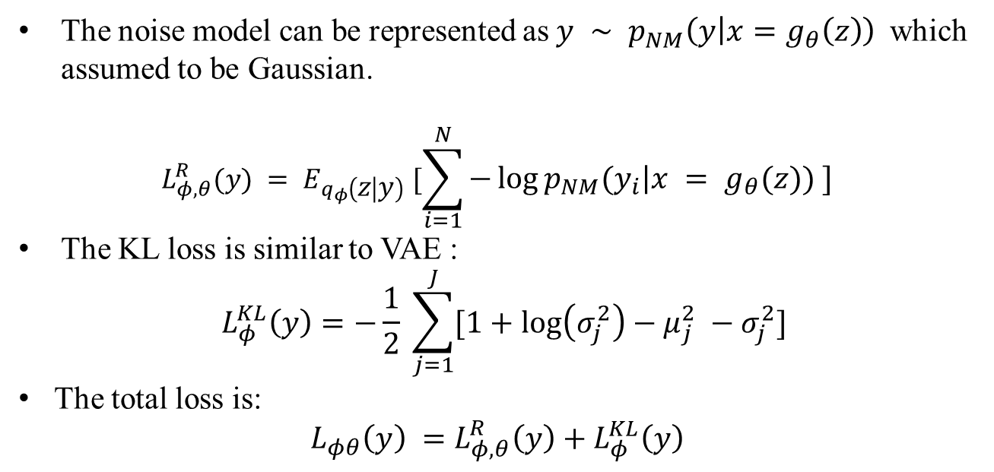
DivNoising
The noise model can be represented as$y ∼ p_{NM}\left(y | x=g_{θ}\left(z\right)\right)$ which assumed to be Gaussian.
$$L_{φ,θ}^{R}(y) = E_{q_{φ}\left(z | y\right)} [\sum_{i=1}^{N}{−\log{p_{NM}\left(y_{i} | x = g_{θ}\left(z\right)\right)} ]}$$
The KL loss is similar to VAE :
$${ L}_{φ}^{KL}\left(y\right)=−\frac{1}{2} \sum_{j=1}^{J}{[1+\log\left(σ_{j}^{2}\right)−μ_{j}^{2} −σ_{j}^{2}] }$$
The total loss is:
$${L_{φθ}\left(y\right) =L_{φ,θ}^{R}\left(y\right)+L}_{φ}^{KL}\left(y\right)$$
(Florian Jug et al., 2021)
12

Slide 13
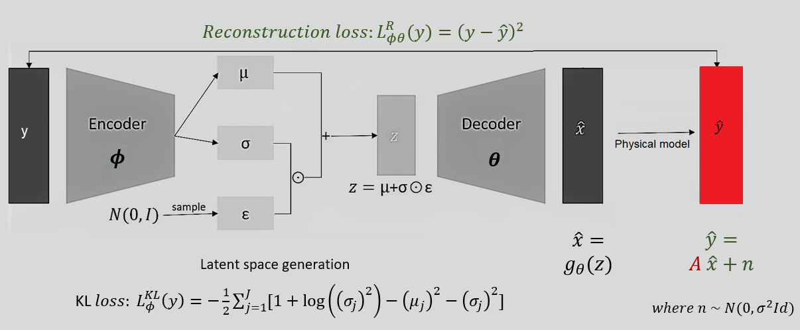
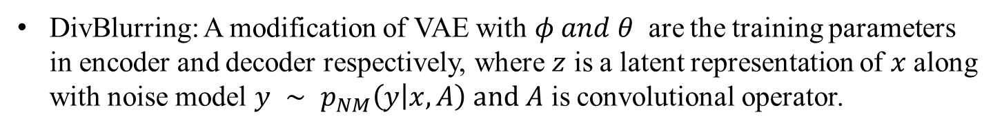
Proposed approach: DivBlurring
DivBlurring: A modification of VAE with $φ and θ$ are the training parameters in encoder and decoder respectively, where $z$ is a latent representation of $x$ along with noise model $y ∼ p_{NM}\left(y | x, A\right)$ $and A$ is convolutional operator.
13

Slide 14
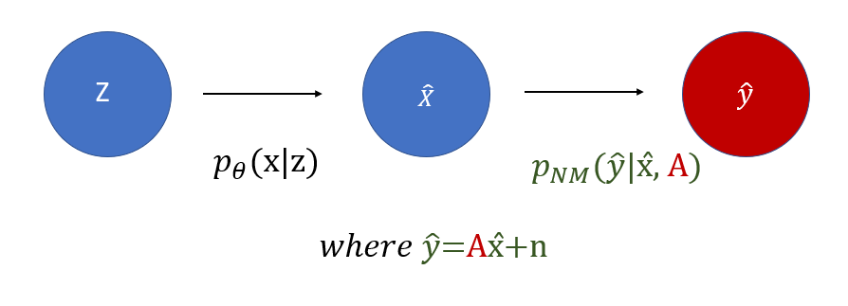
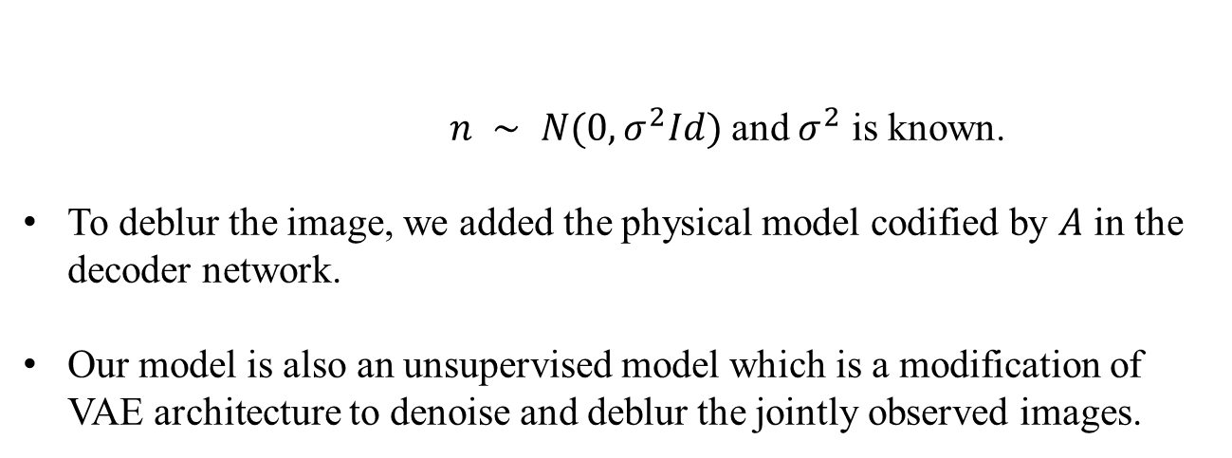
Proposed approach: DivBlurring
$n ∼ N(0, σ^{2}Id)$and $σ^{2}$ is known.
To deblur the image, we added the physical model codified by $A$ in the decoder network.
Our model is also an unsupervised model which is a modification of VAE architecture to denoise and deblur the jointly observed images.
14

Slide 15
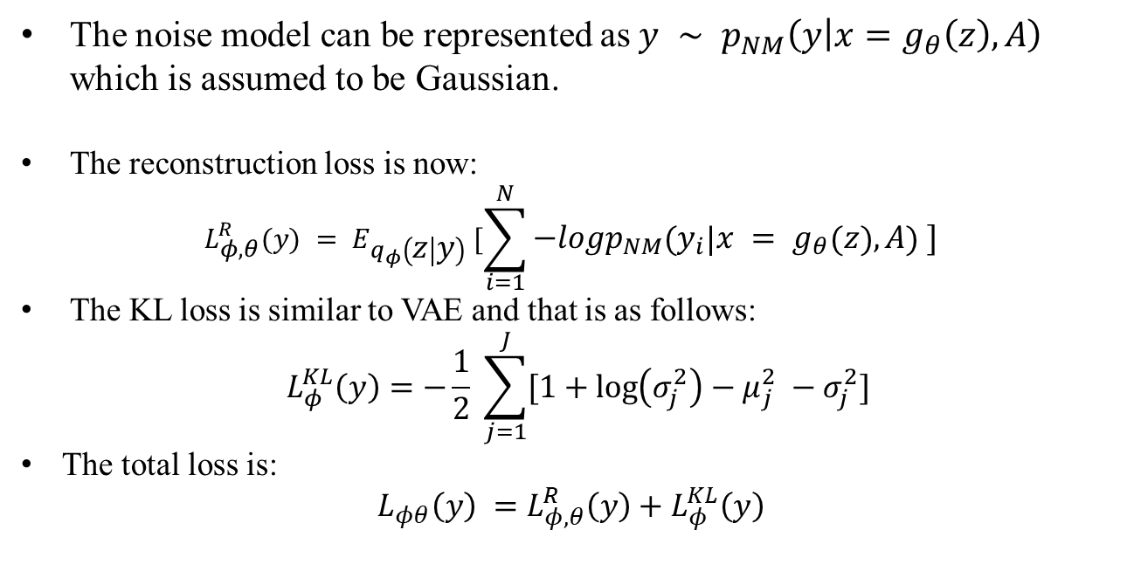
Proposed approach: DivBlurring
The noise model can be represented as$y ∼ p_{NM}\left(y | x=g_{θ}\left(z\right),A\right)$ which is assumed to be Gaussian.
The reconstruction loss is now:
$$L_{φ,θ}^{R}(y) = E_{q_{φ}\left(z | y\right)} [\sum_{i=1}^{N}{−logp_{NM}\left(y_{i} | x = g_{θ}\left(z\right),A\right) ]}$$
The KL loss is similar to VAE and that is as follows:
$${ L}_{φ}^{KL}\left(y\right)=−\frac{1}{2} \sum_{j=1}^{J}{[1+\log\left(σ_{j}^{2}\right)−μ_{j}^{2} −σ_{j}^{2}] }$$
The total loss is:
$${L_{φθ}\left(y\right) =L_{φ,θ}^{R}\left(y\right)+L}_{φ}^{KL}\left(y\right)$$
15

Slide 16
Regularisers
We choose some specific and suitable regularisers are well-known in the mathematical communities and promote understandable properties (sparsity, smoothness, non-negativity).
Regularization is a way to incorporate prior knowledge on the desired solution to the model considered, thus reducing overfitting and underfitting.
16

Slide 17
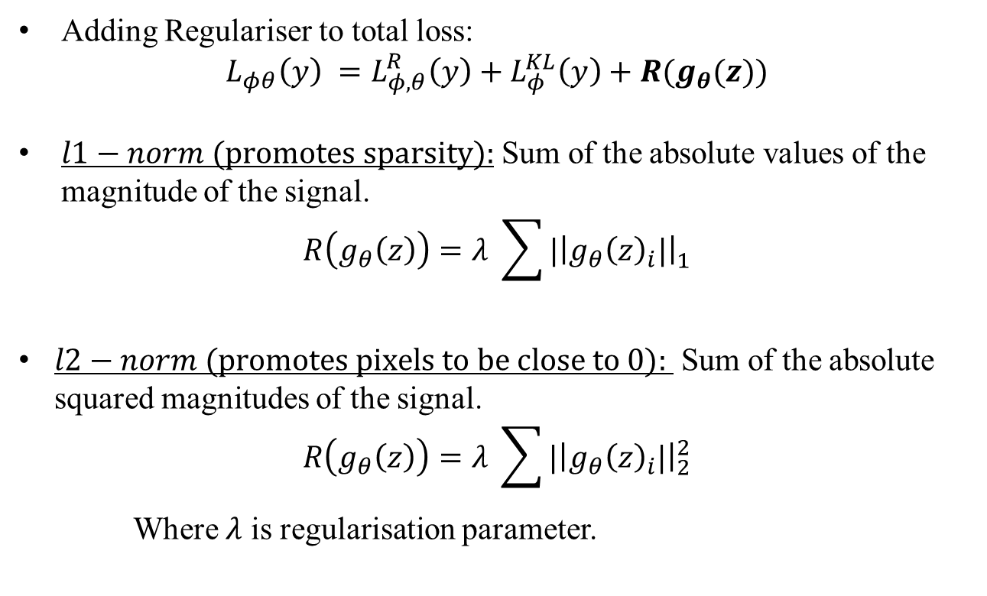
Best match regularisers
Adding Regulariser to total loss:
$${L_{φθ}\left(y\right) =L_{φ,θ}^{R}\left(y\right)+L}_{φ}^{KL}\left(y\right)+R(g_{θ}(z))$$
$l1−norm (\text{promotes} \text{sparsity}):$ Sum of the absolute values of the magnitude of the signal.
$$R\left(g_{θ}\left(z\right)\right)=λ \sum_{ }^{ }{{|\left|g_{θ}{\left(z\right)}_{i}|\right|}_{1}^{ }}$$
$l2−norm (\text{promotes} \text{pixels} \text{to} \text{be} \text{close} \text{to}\text{ 0}):$ Sum of the absolute squared magnitudes of the signal.
$$R\left(g_{θ}\left(z\right)\right)=λ \sum_{ }^{ }{{|\left|g_{θ}{\left(z\right)}_{i}|\right|}_{2}^{2}}$$
Where $λ$ is regularisation parameter.
17

Slide 18
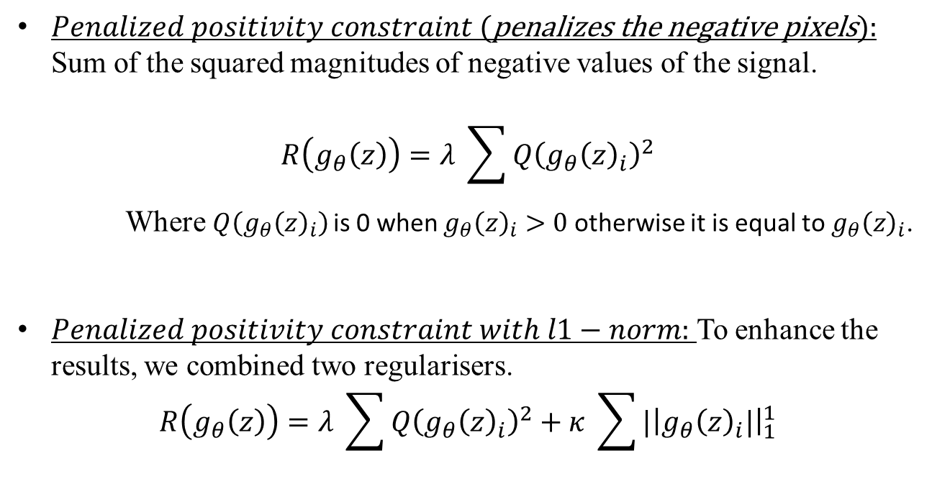
Best match regularisers
$Penalized positivity constraint (\text{penalizes} \text{the} \text{negative} \text{pixels}):$ Sum of the squared magnitudes of negative values of the signal.
$$R\left(g_{θ}\left(z\right)\right)=λ \sum_{ }^{ }{Q{\left(g_{θ}{\left(z\right)}_{i}\right)}^{2}}$$
Where $Q{\left(g_{θ}{\left(z\right)}_{i}\right)}^{ }$is 0 when $g_{θ}{\left(z\right)}_{i}>0$ otherwise it is equal to $g_{θ}{\left(z\right)}_{i}$.
$Penalized positivity constraint with l1−norm:$ To enhance the results, we combined two regularisers.
$$R\left(g_{θ}\left(z\right)\right)=λ \sum_{ }^{ }{Q{\left(g_{θ}{\left(z\right)}_{i}\right)}^{2}}+κ \sum_{ }^{ }{{|\left|g_{θ}{\left(z\right)}_{i}|\right|}_{1}^{1}}$$
18

Slide 19
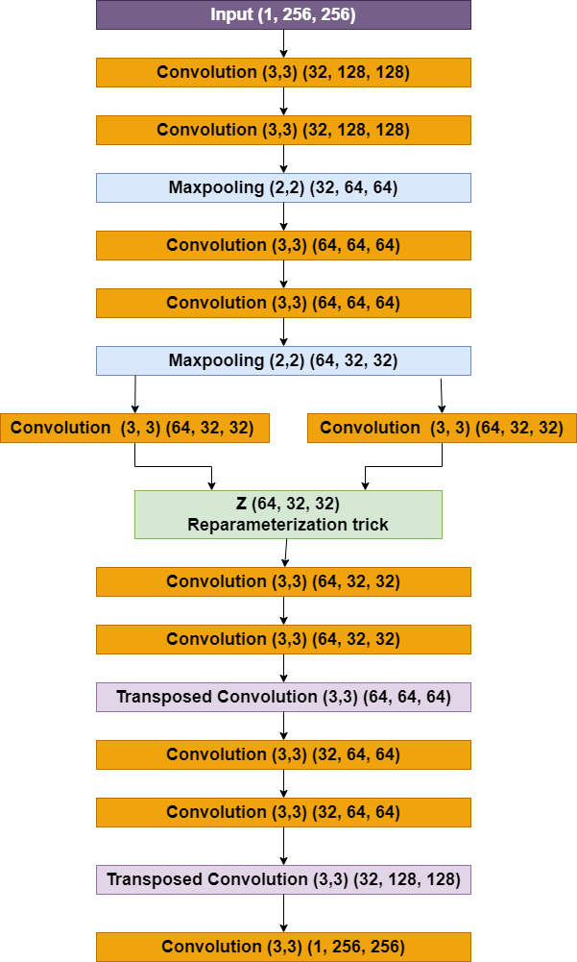
Model Architecture
Input image size : (1 X 256 X 256)
LR: 0.001, Optimizer: Adam, Batch size: 32, Epochs: 150
2 down sampling networks in encoder part with 2 convolution layers each and 2 up sampling networks in decoder part with 2 convolution layers each.
After training, 100 samples are picked from the latent space and then averaged with MSE for single input for better estimation.
19

Slide 20
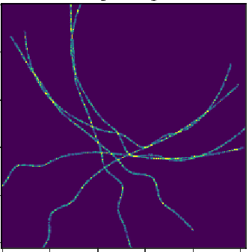
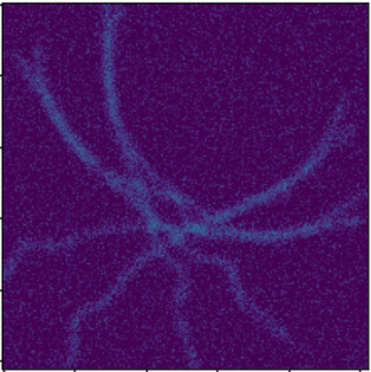
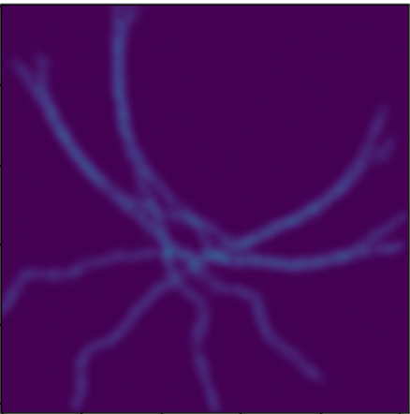
Results of DivNoising
A: Signal B: Input signal C: Results of DivNoise
On keen observation, the results are denoised very well, but in the case of deblurring this approach is not sufficient.
20

Slide 21
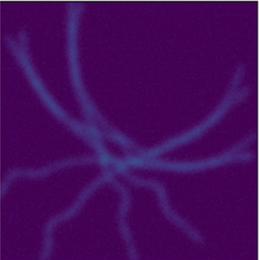
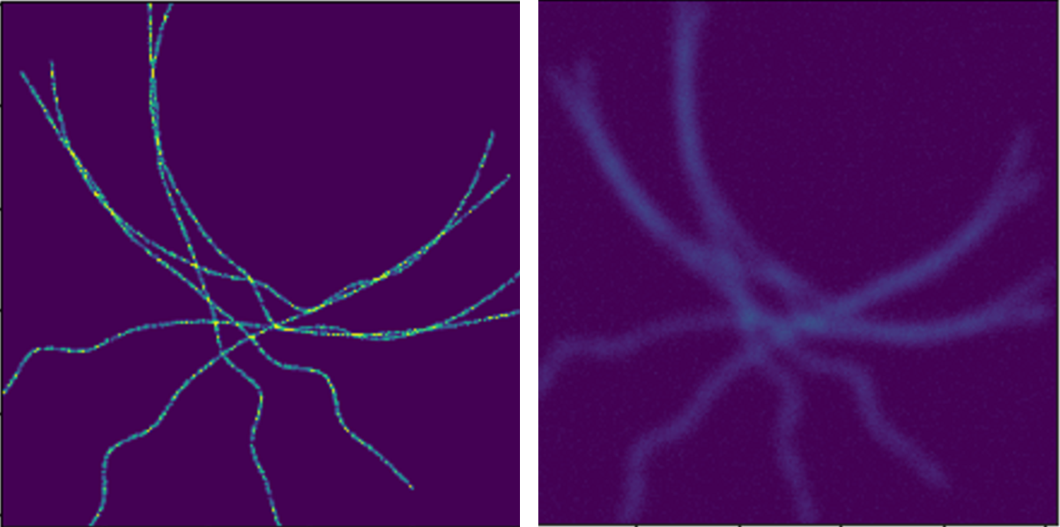
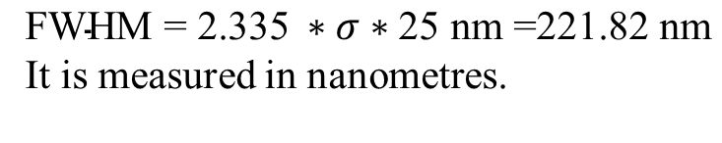
Results: dataset-1
Synthetic data created in MATLAB.
DataSet-1 (low noise and blur ) which is nearer to realistic data.
PSF used to blur the data have a full width at half maximum (FWHM), sigma equal to 3.8.
Noise level with Gaussian sigma is equal to 2.
Total dataset size is 7000 images with different noise realisations.
A: Ground truth B: Blur and noisy images
$$\text{FWHM}\text{ = 2.335} ∗σ∗\text{25 }\text{nm}\text{ =}\text{221.82} \text{nm}$$
It is measured in nanometres.
21

Slide 22
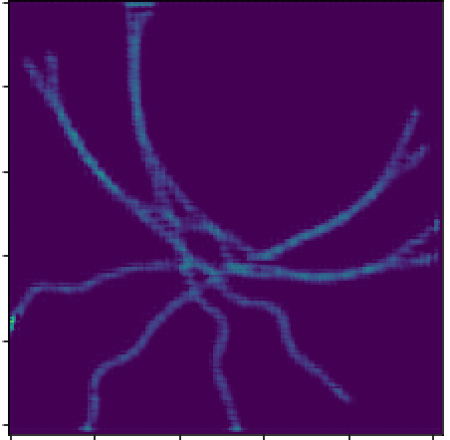
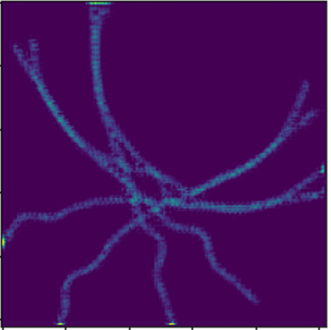
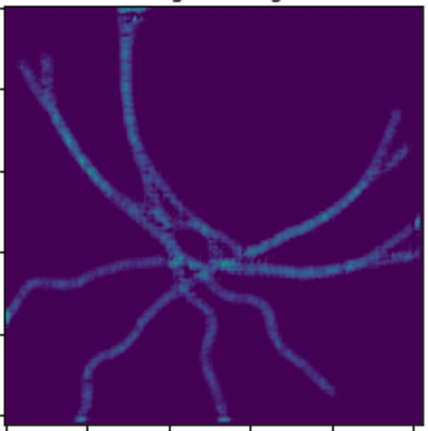
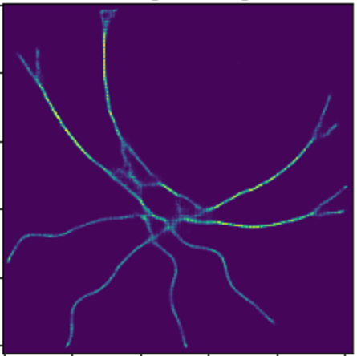
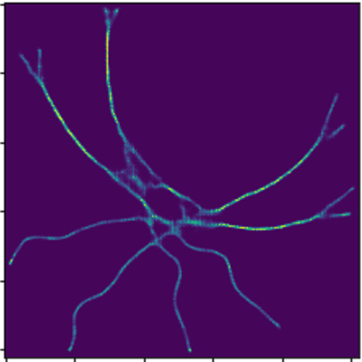
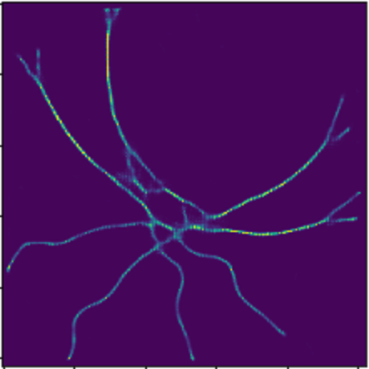
Results dataset-1
Div-Blurring (DB) DB with ℓ1, $λ$= 1e-10 DB with ℓ2, $λ$=1e-10
DB with PC, $λ$= 1e-3 DB with PC, $λ$= 1e-5 DB with (1e-3) PC+ (1e-10)ℓ1
22

Slide 23
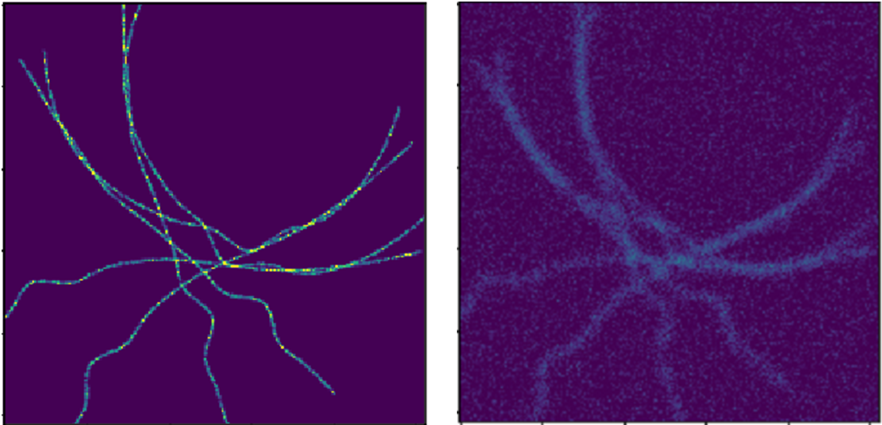
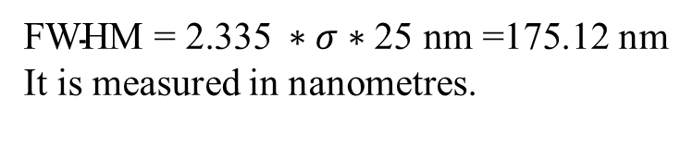
Results dataset-2
Synthetic data created in MATLAB.
DataSet-2 (high noise and blur )
PSF used to blur the data have a full width at half maximum (FWHM), sigma equal to 3.0.
Noise level with Gaussian sigma is equal to 10.
Total dataset size is 7000 images with different noise realisations.
A: Ground truth B: Blur and noisy images
$\text{FWHM}\text{ = 2.335} ∗σ∗\text{25 }\text{nm}\text{ =175.12}$ nm
It is measured in nanometres.
23

Slide 24
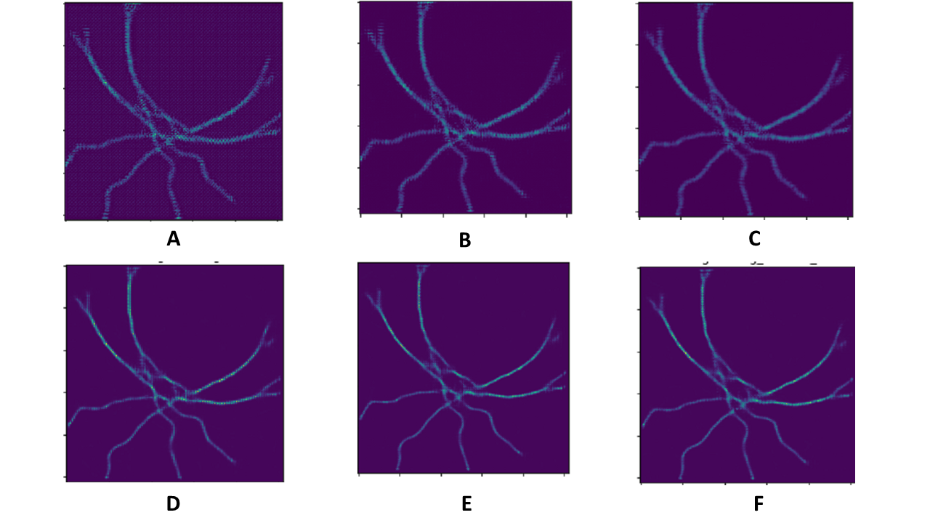

Results-dataset-2
Div-Blurring (DB) DB with ℓ1, $λ$= 1e-10 DB with ℓ2, $λ$=1e-10
DB with PC, $λ$= 1e-3 DB with PC, $λ$= 1e-5 DB with (1e-3) PC+ (1e-10) ℓ1
25

Slide 25
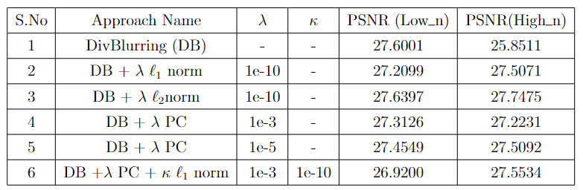
Results
The background range is impacting the total PSNR value though visually results are good in DivBlurring with the positivity constraint and a regularization parameter equal to 1e-3.
25

Slide 26
Results of comparison
A: True Signal B: Results of DivBlurring C: Results of DivNoising
PSNR = 27.3126 PSNR = 27.2721
Our approach "DivBlurring" introduce a deblurring step and gives a visually good results. The background values are impacting the PSNR.
26

Slide 27
Conclusion
Existing approaches based on VAEs can denoise the images, but they are not adapted for deblurring.
Our approach ”DivBlurring” can visually outperform by introducing a deblurring step.
Future work
Different architectures can be integrated such as VAE GAN, s3VAE and CVAE.
Can be extended not just limiting to fluorescence microscopic images.
Other regularisation terms as total variation and Huber’s regularisers to test.
27

Slide 28
Thank you
28

Slide 29
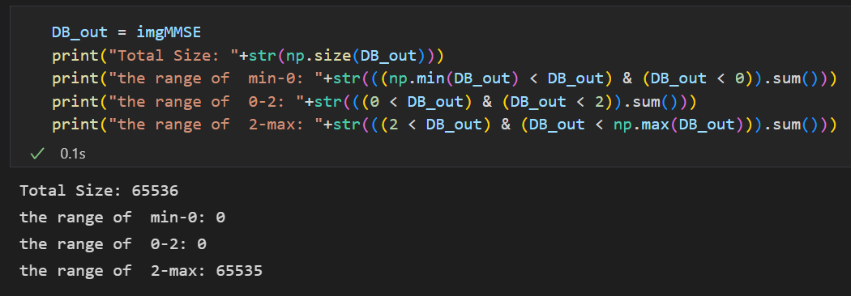
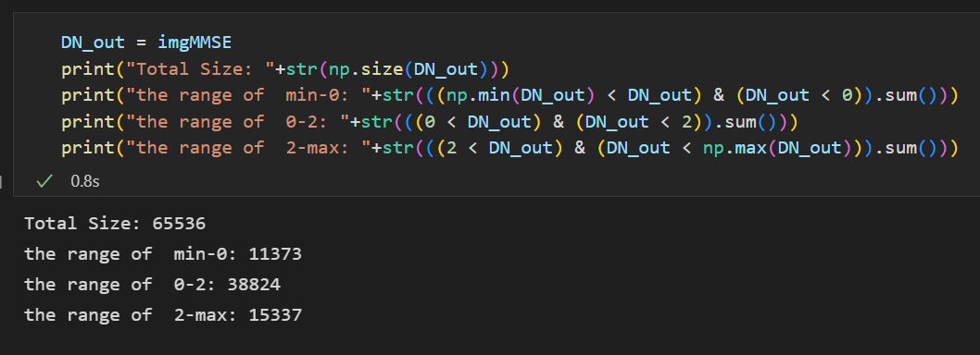
29

